Slide 1
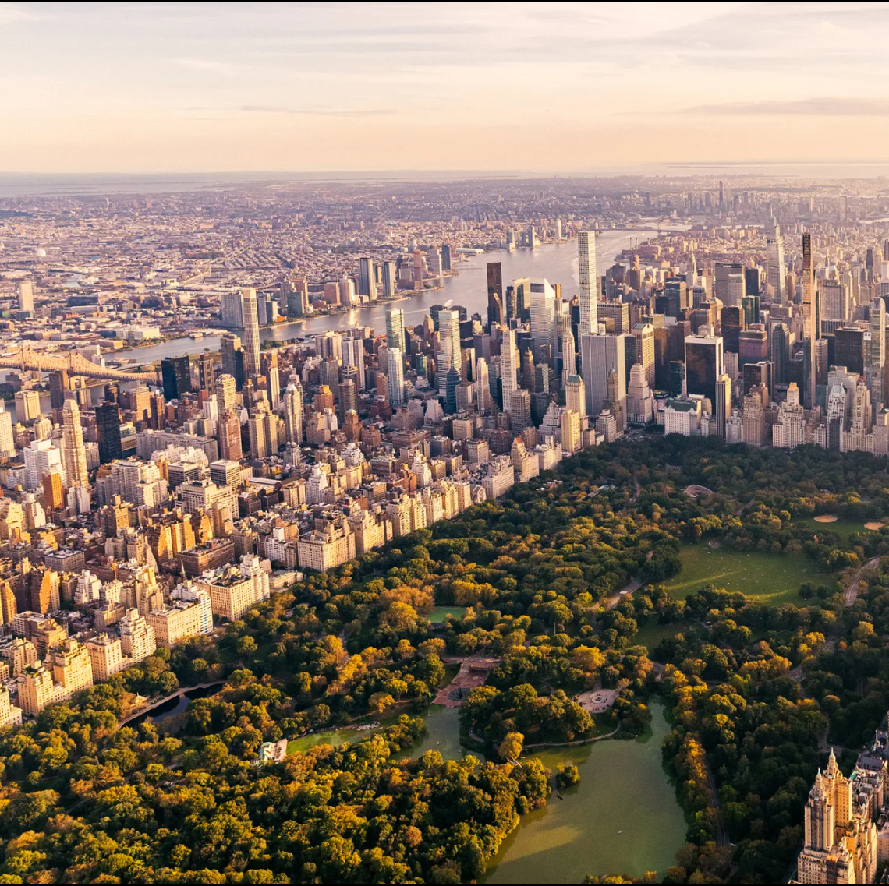
Tackling Environmental Justice with One Backpack in New York Neighborhoods
Katie Colasono
Group 159

Slide 2

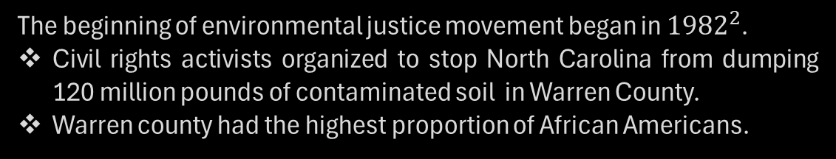
What is Environmental Justice?
Environmental justice is when populations with lesser capacity to influence environmental decisions have an inequitable share of the negative impacts of the ${environment}^{1}$.
The beginning of environmental justice movement began in ${1982}^{2}$.
Civil rights activists organized to stop North Carolina from dumping 120 million pounds of contaminated soil in Warren County.
Warren county had the highest proportion of African Americans.
Numerous studies have found that ethnic minorities and low-income communities have a higher burden of environmental pollution.

Slide 3
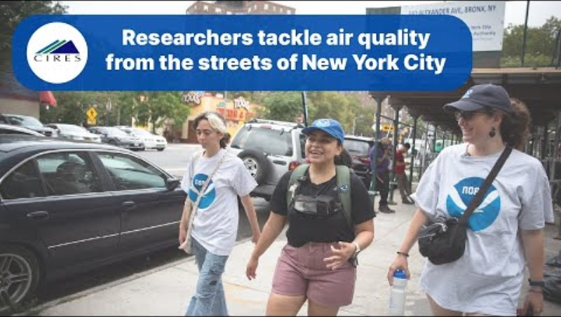
How can we fight for Environmental Justice?
By providing communities with the information about pollution to able to fight for environmental justice.
Last summer, Dr. Audrey Gaudel partnered with New York researchers to do just this!
She and her colleagues collected air quality measurements for Ozone and PM2.5 using instruments carried in backpacks.
They covered several areas in New York with over 30 walks in 22 days.
Check out the video to see them collecting the data on the streets!

Slide 4
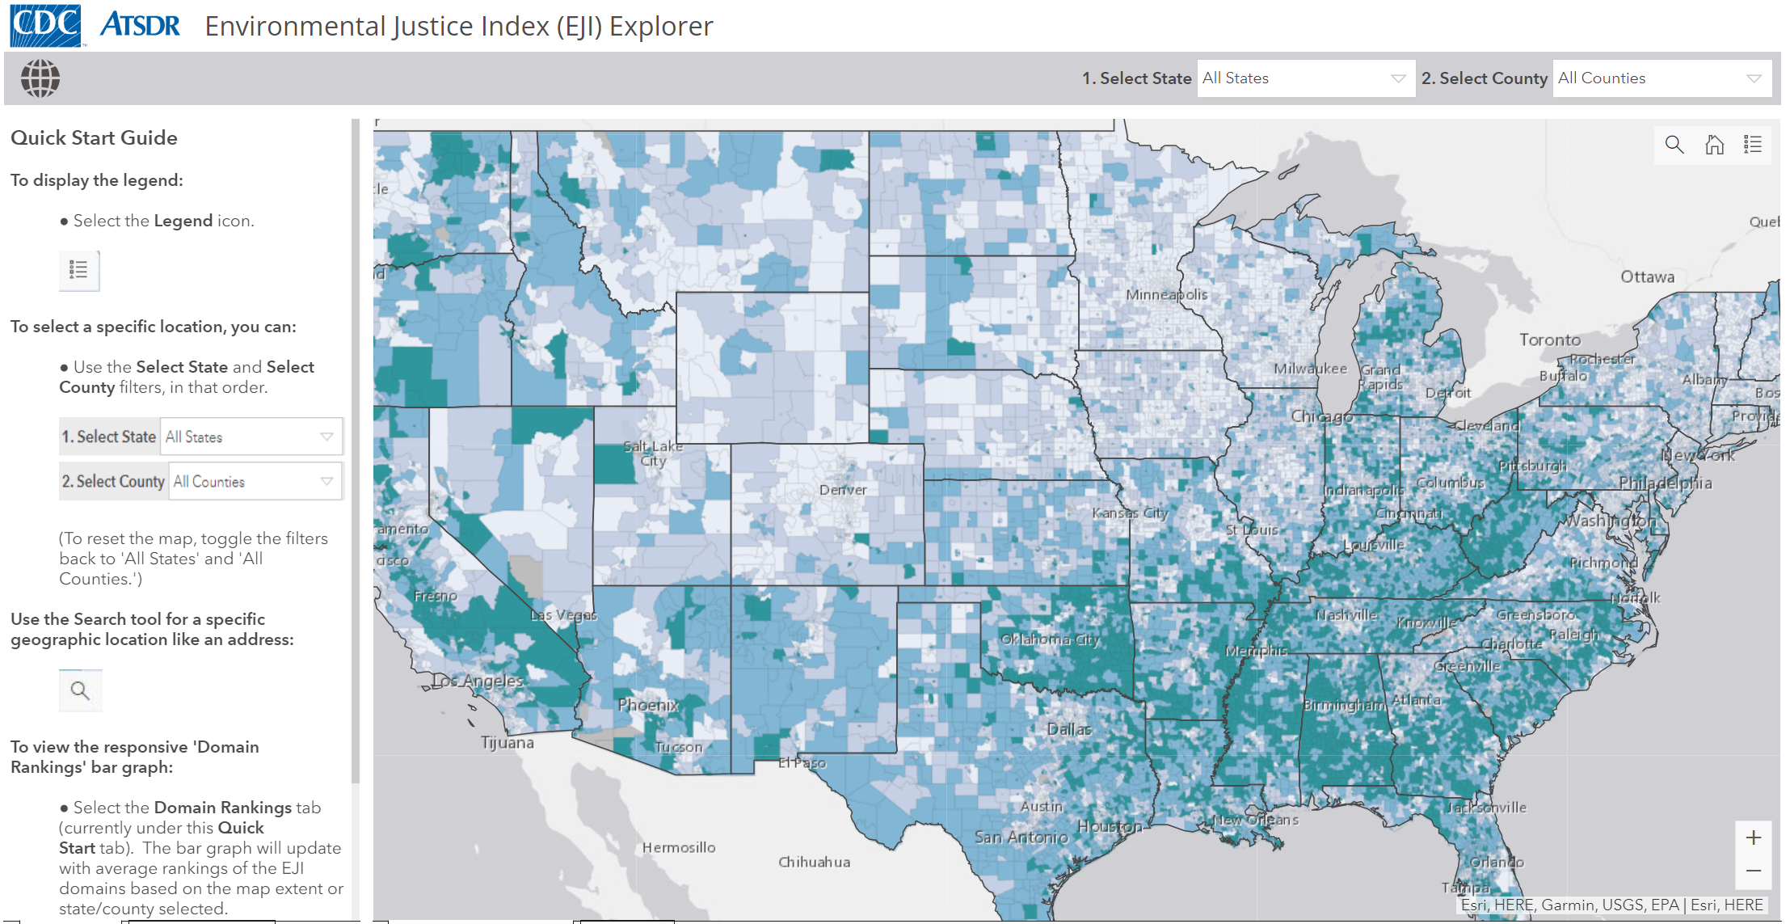
A bit more background…
The CDC provides an environmental justice (EJI) score for (almost) every census tract in the United States.
Factors included in this score are air quality measurements, pre-existing conditions of the communities, and socio-demographic data.
Air quality measurements include PM2.5 and Ozone concentration levels – the same measurements that Dr. Gaudel and her colleagues measured in New York.
Most of the socio-demographic data is complied into one rank called the Social Vulnerability Rank (SVR).
The SVR is considered in the EJI score, as well.
Clicking on the image will route to the CDC’s EJI Explorer

Slide 5
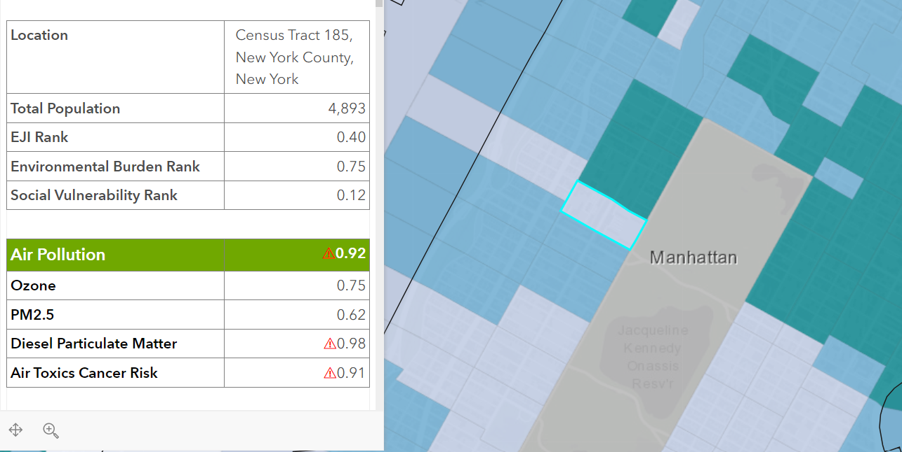
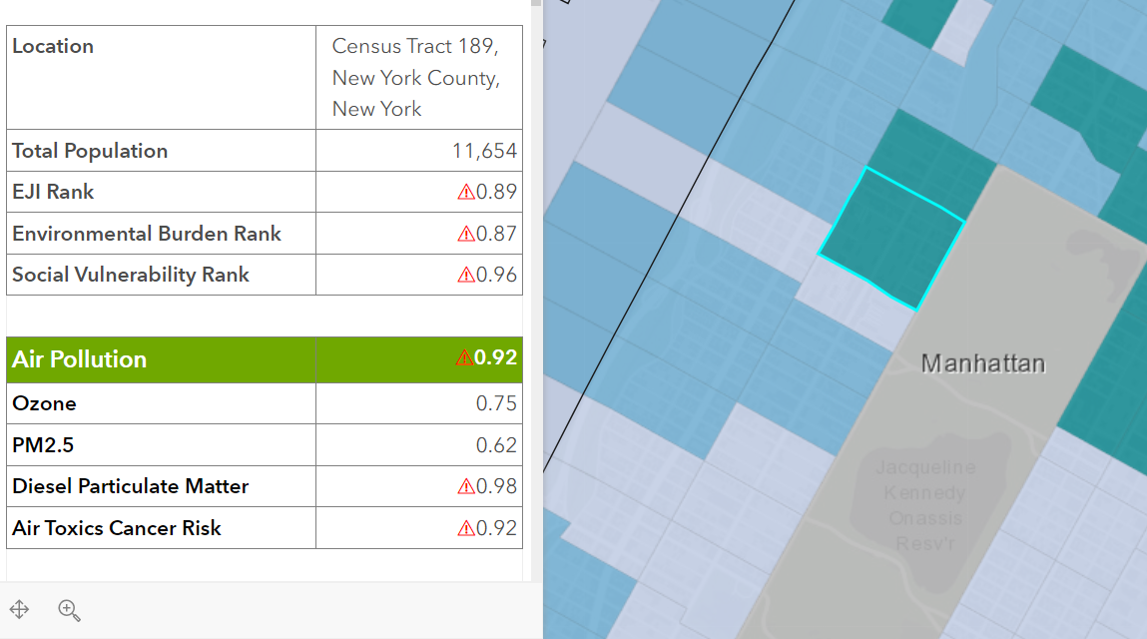
A bit more background…
The EJI suggests that one New York neighborhood may have a higher EJI score than another – but they are only separated by one street – this seems unrealistic.
The maps below are from the CDC’s EJI interactive tool.
Two different census tracts parallel to each are highlighted
Left image => EJI of 0.40; SVR of 0.12.
Right image => EJI of 0.89; SVR of 0.96
Both neighborhoods have an Ozone of 0.75 and a PM2.5 of 0.62
If both neighborhoods have the same air quality, then is it the SVR that is driving the EJI? Do neighborhoods in New York differ substantially in air quality?

Slide 6

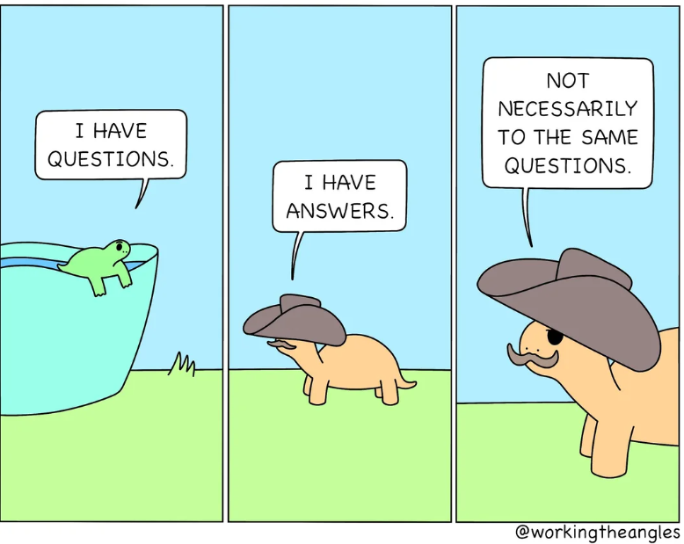
Proposed Questions
How do the EJI ranks compare amongst New York counties? Specifically, the counties of Queens, Kings, the Bronx and New York City (i.e., central New York).
Are the PM2.5 measurements from the New York backpack campaign and EJI’s PM2.5 levels comparable?
Are census tracks with a higher social vulnerability rank paired with higher EJI ranks?

Slide 7




Methodology
Data Acquisition
Data Cleaning
Data Caveats
Data Analysis
Backpacking PM2.5 data was collected for every 15 minutes in three New York counties for 22 days.
EJI ranks + air-quality measurements + socio-economic data was collected from the CDC website for four NY counties (Kings, Bronx, NY and Queens).
Each walk in the backpacking campaign is labeled as specific NY county.
Each census tract in EJI data is given a label of “minority” if the % of minorities in that tract is higher than the average for the county.
EJI’s PM2.5 measurements are based on CDC predicted estimates of PM2.5 from 2014-2016 (not an up-to-date measurement). When comparing EJI PM2.5 and the backpacking PM2.5 concentration levels, the CDC’s predicted measurements from Aug to July 2016 are used.
Exploratory analysis is conducted to answers the questions comparing PM2.5 and ranks between counties using boxplots and histograms.
Clustering analysis is used to determined if high SVR’s are grouped with high EJI’s (discussed in more detail later).

Slide 8

Exploratory Analysis

Slide 9
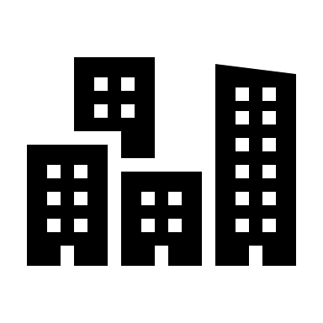
Question: How do the EJI ranks compare amongst New York counties?

Slide 10
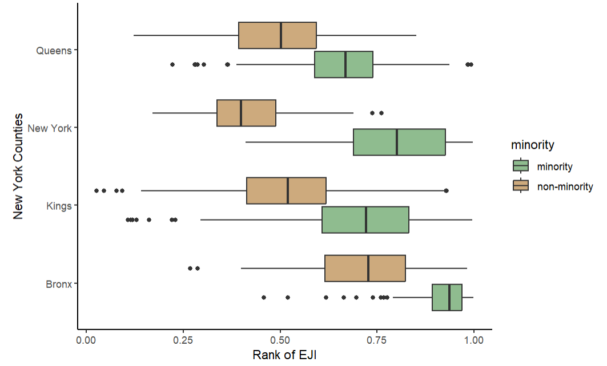
Minority tracts = Higher EJI
Minority (green) vs non-minority (brown) census tracts are shown for four New York counties in the boxplot to the right, along with their respective EJI ranks.
Every county has higher EJI ranks for minorities than non-minorities.
New York county has the biggest disparity – also the county with the largest population of white people among the four counties here.

Slide 11
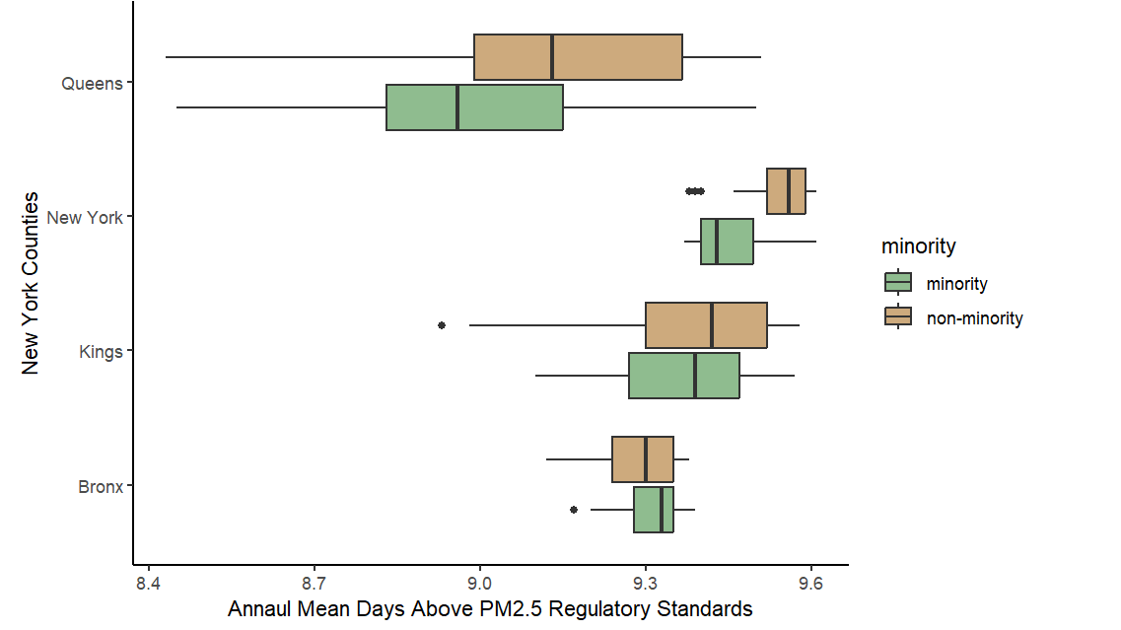
No difference for air quality measurements
Minority (green) vs non-minority (brown) census tracts are shown for four New York counties in the boxplot to the right, with their respective annual mean days above PM2.5 regulatory standards (an EJI metric).
Each county spends about 9-9.5 days above the regulatory standard per year.
Queens has the largest spread – and spends about ~0.5 days less above the standard each year.
There is not an obvious difference between minority and non-minority census tracts between each county in the number of days spent above regulatory standards for PM2.5.

Slide 12
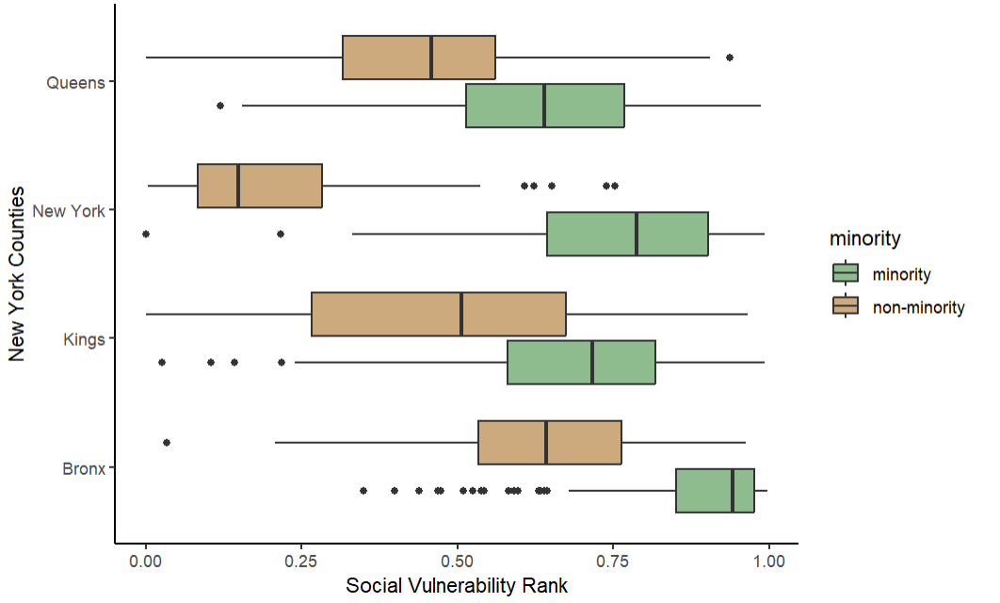
Minority tracts = Higher SVR
Minority (green) vs non-minority (brown) census tracts are shown for four New York counties in the boxplot to the right, with their respective Social Vulnerability Ranks.
Minority census tracts have a higher social vulnerability rank than non-minority tracts.
Kings and Queens have the largest spread.
New York county has the biggest difference between non-minority and minority census tracts.

Slide 13

Possible Conclusion: Minority census tracts have higher EJI’s and SVR’s, but census tracts do not differ on the number of days above regulatory standards.

Slide 14
Question: Are the PM2.5 measurements from the New York backpack campaign and EJI’s PM2.5 levels comparable?

Slide 15
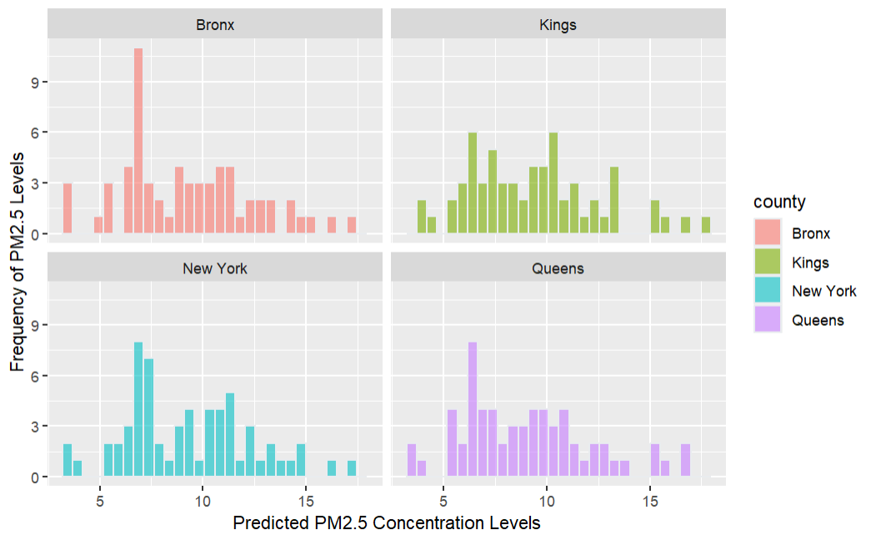
CDC Predicted 15 days above standards
The histograms to the left show the predicted PM2.5 concentration levels from the CDC across the four NY counties of interest from Aug – July 2016.
The range for PM2.5 concentration levels from the CDC are between ~0 to 20.
The 2016 regulatory standard for PM2.5 is anything above 12
CDC predicted that these counties would experience about ~15 days above the standard within these two months.
Note: EJI uses CDC’s predicted values for PM2.5 concentration levels and not actual values.
The current concentration levels used in EJI are from 2014 to 2016.
Thus, they are not accurate air quality measurements for the current conditions in New York.

Slide 16
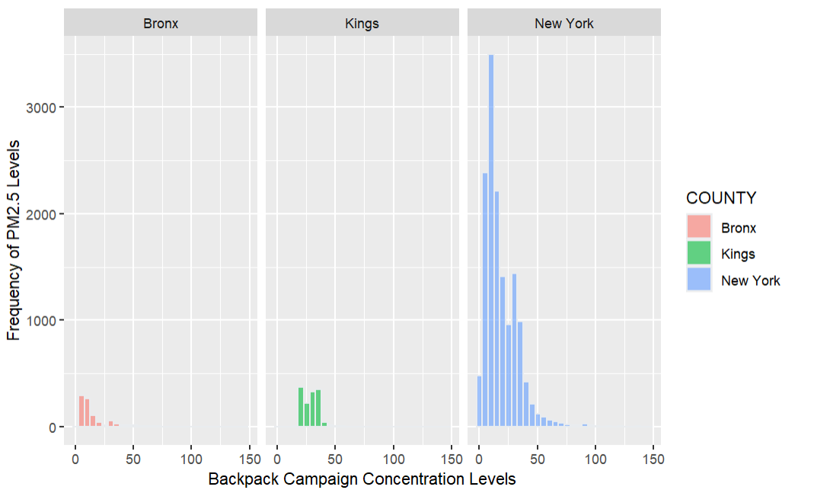
Backpacking PM2.5 levels are much higher!
The histograms to the left show the PM2.5 concentration levels from the backpack campaign for all walks.
The backpacking campaign measured PM2.5 concentration levels every 15 mins.
The walks occurred over three counties: Bronx, New York and Kings.
The concentration levels recorded during the walks are much higher than the predicted levels from the CDC (used in the EJI ranks).
There are also much higher levels of PM2.5.
Indicating that the EJI concentration levels are not accurate enough and need to be more specific to each census tract.

Slide 17
Possible Conclusion: The backpack campaign shows that PM2.5 concentration levels are much higher than represented by the EJI estimated values.

Slide 18
Clustering Analysis

Slide 19
Methodology
Testing & Training
Data Models
Optimal Clusters
Conclusions
Clustering analysis was done for each of the four counties. The data was in a 70/30 ratio for training and testing.
Although splitting the data may have not been needed for this analysis since it may not be used for predication purposes.
Data was also normalized.
Two types of cluster models were completed:
A base model with PM2.5, EJI and SVR
A model with other factors that correlated with EJI at a rate higher than 0.6.
For simplicity, the testing results will only be shared.
Optimal clusters found through the silhouette coefficient (a measure to find how similar a data point is within a cluster compared to other clusters).
Different metric distances were all tested but all performed relatively the same, so the Euclidian distance was used.
Summary statistics were calculated per cluster group.
Significance tests were conducted to determine if the clusters for say, PM2.5, had significant differences.

Slide 20
Question: Are census tracks with a higher social vulnerability rank paired with higher EJI ranks?

Slide 21
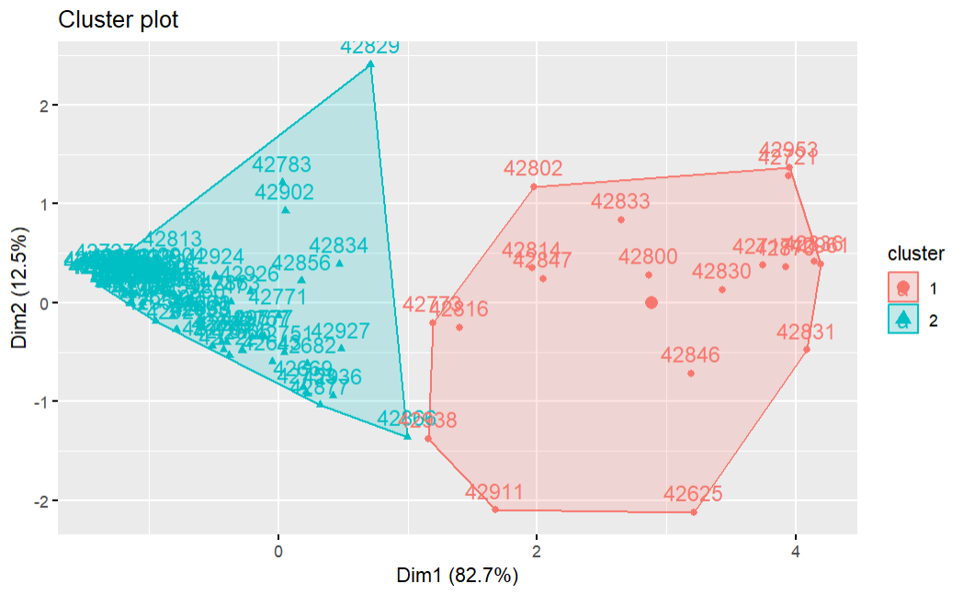
Bronx – Simple Model
For the basic model, the optimal number of clusters is 2 for each county.
The within-clusters sum of squares (66.4%) and average silhouette width determine (0.68) that this model is moderately good at clustering these two groups but could use improvement.
However, it is clear from the statistics summaries that the minorities have higher EJI and SVR scores – these are statistically different.
 | Cluster 1 (non-minorities) | Cluster 2 (minorities)
N | 19 | 80
PM2.5 | 9.28 | 9.32
EJI | 0.65 | 0.92
SVR | 0.58 | 0.91

Slide 22
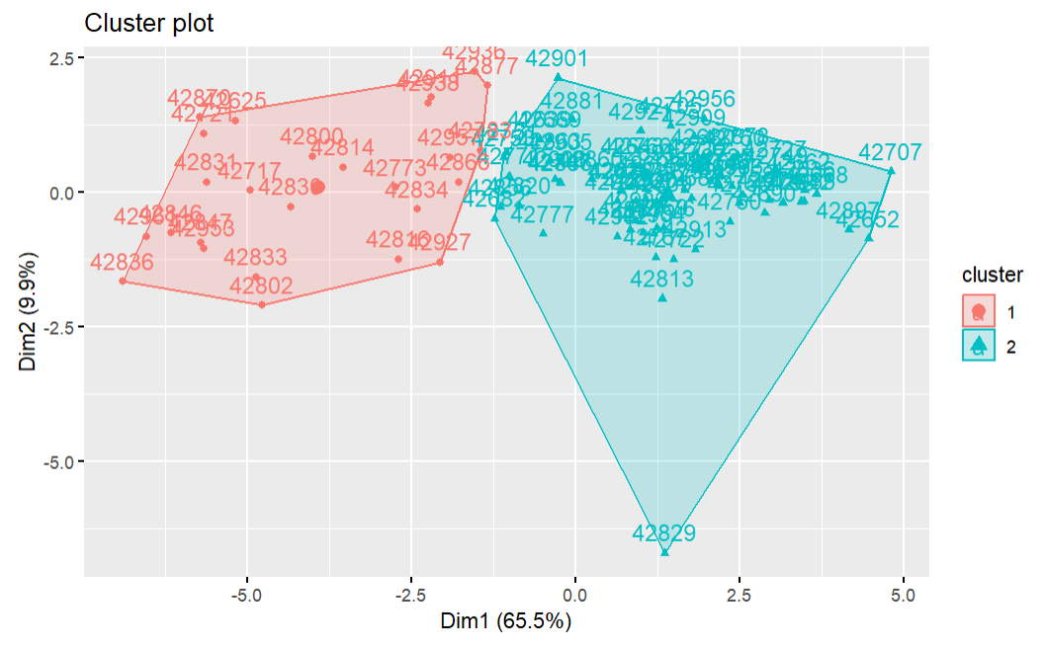
Bronx – Complex Model
The complex model included 12 socio-demographic variables + EJI rank – and the optimal clusters remained at 2.
The within-clusters sum of squares (46.4%) and average silhouette width determine (0.45) that this model performs substantially worse than the basic model with three variables.
The summary statistics included below are only a select few. Minority census tracts have higher rates of being blow poverty lines, having asthma and renting. However, the cancer variable indicates census tracts with higher rates of cancer – it is consistently the non-minority tracts in each county that have higher rates of cancer.
 | Cluster 1 (non-minorities) | Cluster 2 (minorities)
N | 26 | 73
EJI | 0.70 | 0.93
Renter | 52% | 89%
Asthma | 10.6% | 12.6%
Poverty below 200% | 24.8% | 58.5%
Cancer | 0.34 | 0

Slide 23
Summarized results for remaining counties
New York has the best model performance out of all other counties for the simplistic and complex model
King’s complex model performed the worst.
Queens’s complex model had a similar performance to New York’s, but its silhouette width is too low.
The differing performances between counties indicates that more refinement of the clustering algorithm is needed and perhaps that different counties need different clustering algorithms.
 | Kings |  | Queens |  | New York |  | Bronx
 | Simple | Complex | Simple | Complex | Simple | Complex | Simple | Complex
Optimal Clusters | 2 | 2 | 2 | 5 | 2 | 2 | 2 | 2
Within-Clusters SS | 51.8% | 37.9% | 49.0% | 58.8% | 77.2% | 60.7% | 66.4% | 46.4%
Average Silhouette Width | 0.44 | 0.3 | 0.43 | 0.26 | 0.64 | 0.5 | 0.68 | 0.45

Slide 24
Possible Conclusion: Clustering algorithms need more refinement. However, in general the algorithms clustered higher EJIs with higher SVRs.

Slide 25
Conclusions

Slide 26

Conclusions & Further Research
Minority census tracts have higher EJI’s and SVR’s, but census tracts do not differ on the number of days above regulatory standards.
The backpack campaign shows that PM2.5 concentration levels are much higher than represented by the EJI estimated values.
Clustering algorithms need more refinement. It is possible that the counties need modified versions of the clustering algorithms, as well.
The basic model explains the most variance within the clusters.
In general the algorithms clustered higher EJIs with higher SVRs.
A more granular comparison of the PM2.5 levels from EJI and backpack campaign will provide more accurate measurement of how well EJI is capturing PM2.5 levels.

Slide 27
Sources
https://www.atsdr.cdc.gov/placeandhealth/eji/docs/EJI-2022-Documentation-508.pdf
https://www.annualreviews.org/content/journals/10.1146/annurev-environ-082508-094348

